Slide 1
CSC 3210 Computer Organization and Programming
Lab Work 12
Dr. Zulkar Nine
mnine@gsu.edu
Georgia State University
Spring 2021

Slide 2
Learning Objective
Integer Arithmetic

Slide 3
Disclaimer
The process shown in these slides might not work in every single computer due to Operating system version, Microsoft Visual Studio versions and everything.
If you find any unusual error, you can inform the instructor.
Instructor will help you resolve the issue.

Slide 4
Attendance!

Slide 5
Lab Work 12 Instructions
Lab 12 : Expression evaluation
Due Date: 04/16/21 11:59 PM

Slide 6
Plan early …
You have one week time to submit the lab
Start early
If you have issues
Email TA or instructor
Stop by during office hours
Start working at the last moment is not a good idea.
AppendixA shows how to check memory data and Appendix B shows how to create a new project.

Slide 7
Problems in this lab
You might see similar questions in the quizzes and exam.
During the exam you might need solve similar problems without visual studio.

Slide 8
MUL Instruction
In 32-bit mode, MUL (unsigned multiply) instruction multiplies an 8-, 16-, or 32-bit operand by either AL, AX, or EAX.
The instruction formats are:
Multiplier operands
Notes:
EDX: The Data Register
Of the seven remaining general-purpose registers, the data register, EDX, is most closely tied to the accumulator. Instructions that deal with over sized data items, such as multiplication, division, CWD, and CDQ, store the most significant bits in the data register and the least significant bits in the accumulator. In a sense, the data register is the 64-bit extension of the accumulator. The data register also plays a part in IO instructions. In this case, the accumulator holds the data to read or write from the port, and the data register holds the port address.
EAX - All major calculations take place in EAX, making it similar to a dedicated accumulator register.
EDX - The data register is the an extension to the accumulator. It is most useful for storing data related to the accumulator's current calculation.
ECX - Like the variable i in high-level languages, the count register is the universal loop counter.
EDI - Every loop must store its result somewhere, and the destination index points to that place. With a single-byte STOS instruction to write data out of the accumulator, this register makes data operations much more size-efficient.
ESI - In loops that process data, the source index holds the location of the input data stream. Like the destination index, EDI has a convenient one-byte instruction for loading data out of memory into the accumulator.
ESP - ESP is the sacred stack pointer. With the important PUSH, POP, CALL, and RET instructions requiring it's value, there is never a good reason to use the stack pointer for anything else.
EBP - In functions that store parameters or variables on the stack, the base pointer holds the location of the current stack frame. In other situations, however, EBP is a free data-storage register.
EBX - In 16-bit mode, the base register was useful as a pointer. Now it is completely free for extra storage space.

Slide 9
MUL Instruction
Multiplier operands
The instruction formats are:
Because the destination operand is
twice the size of the multiplicand and multiplier, overflow cannot occur.
The colon (:) means concatenation. This means that DX are the bits 16-31 and AX are bits 0-15 of the input number
over sized data
Notes:
EDX: The Data Register
Of the seven remaining general-purpose registers, the data register, EDX, is most closely tied to the accumulator. Instructions that deal with over sized data items, such as multiplication, division, CWD, and CDQ, store the most significant bits in the data register and the least significant bits in the accumulator. In a sense, the data register is the 64-bit extension of the accumulator. The data register also plays a part in IO instructions. In this case, the accumulator holds the data to read or write from the port, and the data register holds the port address.
EAX - All major calculations take place in EAX, making it similar to a dedicated accumulator register.
EDX - The data register is the an extension to the accumulator. It is most useful for storing data related to the accumulator's current calculation.
ECX - Like the variable i in high-level languages, the count register is the universal loop counter.
EDI - Every loop must store its result somewhere, and the destination index points to that place. With a single-byte STOS instruction to write data out of the accumulator, this register makes data operations much more size-efficient.
ESI - In loops that process data, the source index holds the location of the input data stream. Like the destination index, EDI has a convenient one-byte instruction for loading data out of memory into the accumulator.
ESP - ESP is the sacred stack pointer. With the important PUSH, POP, CALL, and RET instructions requiring it's value, there is never a good reason to use the stack pointer for anything else.
EBP - In functions that store parameters or variables on the stack, the base pointer holds the location of the current stack frame. In other situations, however, EBP is a free data-storage register.
EBX - In 16-bit mode, the base register was useful as a pointer. Now it is completely free for extra storage space.

Slide 10
MUL Instruction
The Carry flag indicates whether or not the upper half of the product contains significant digits (?)
Because the destination operand is
twice the size of the multiplicand and multiplier, overflow cannot occur.
Notes:
TU Oct-24,9:30am
Sec06, April3rd

Slide 11
MUL: Example1
Example1: 100h * 2000h, unsigned 16-bit operands:
Because the destination operand is
twice the size of the multiplicand and multiplier, overflow cannot occur.
.data
val1 WORD 2000h
val2 WORD 0100h
.code
mov ax,val1
mul val2 ; DX:AX = 00200000h, CF=1
The Carry flag indicates whether or not the upper half of the product contains significant digits (?)
Result = 200000h

Slide 12
MUL Instruction
The Carry flag indicates whether or not the upper half of the product contains significant digits (?)
Because the destination operand is
twice the size of the multiplicand and multiplier, overflow cannot occur.
Notes:
TU Oct-24,9:30am
Sec06, April3rd

Slide 13
DIV Instruction
The DIV (unsigned divide) instruction performs 8-bit, 16-bit, and 32-bit division on unsigned integers
A single operand is supplied (register or memory operand), which is assumed to be the divisor
Instruction formats:
DIV reg/mem8
DIV reg/mem16
DIV reg/mem32
divisor

Slide 14
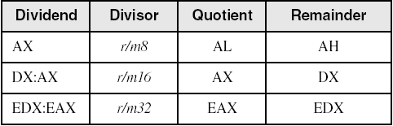
DIV Instruction
The DIV (unsigned divide) instruction performs 8-bit, 16-bit, and 32-bit division on unsigned integers
DIV reg/mem8
DIV reg/mem16
DIV reg/mem32
divisor

Slide 15
DIV: Example1
The following instructions perform 8-bit unsigned division (83h/2),
producing a quotient of 41h
and a remainder of 1
mov ax,0083h ; dividend
mov bl,2 ; divisor
div bl ; AL = 41h, AH = 01h

Slide 16
Signed Arithmetic Expressions
Example1: var4 = (var1 / var2) * (var3 – 5)
; Assume signed operands
A good reason for checking the Carry flag after executing MUL is to know whether the upper half
of the product can safely be ignored.

Slide 17
Signed Arithmetic Expressions
Example1: var4 = (var1 / var2) * (var3 – 5)
; Assume signed operands 32 bit
mov eax,var1
CDQ
idiv var2 ; EAX = var1 / var2
Sub var3, 5 ; var3 = var3 - 5
imul var3 ; EAX = EAX * var3
jo TooBig ; check for carry
mov var4,eax ; save product
^{TooBig:}
A good reason for checking the Carry flag after executing MUL is to know whether the upper half
of the product can safely be ignored.

Slide 18
Lab 12
Submission

Slide 19
Submission (1)
Convert the following pseudo code into assembly code. ( ‘//’ represents comments)
array1 13h, 14h, 15h, 16h // Each element is 1 Byte long
array2 12h, 13h, 14h, 15h // Each element is 1 Byte long
length1 = number of items in Array1. // length1 is a Symbolic constant
length2 = number of items in Array2 // length2 is a Symbolic constant
sample1 = 30h // this variable is 1 byte long initialized with 30
sample2 = 5h. // this variable is 0 byte long
maxlength = max of length1 and length2. // maxlength is 1 byte long variable
index = 0. // this is a variable initialized with 0
While ( index < maxlength ){
If (array1[index] > array2[index]
exp1 = (array1[index] * sample1) / (array2[index] * Sample2)
// only store the quotient of the division in exp1 and exp1 is //16 bit long variable
else
exp1 = 0
index = index + 1
}

Slide 20
Submission (2)
array1 elements are 1 byte long
array2 elements are 1 byte long
length1 and length2 are symbolic constant
sample1 and sample2 are 1 byte long variables initialized with 30h, and 5h respectively
maxlength is a 1 byte long variable and uninitialized in the beginning.
Inside the code section, compute the largest between length1 and lenght2 and store it in the maxlength
Index is a variable that is 1 byte long and initialized with 0
Exp1 is a variable that is 2 byte long.
You are free to use any register and user defined temporary memory variables to store the values.
Your code must produce correct results.
Also handle corner cases (e.g. if the divisor is zero, assign 0 to exp1 )

Slide 21
Submission (3)
Submit the screenshot of your code.
Debug your code until you reach INVOKE ExitProcess, 0
Take a screenshot of the watch window showing variable exp1.
Submit the screenshot.
Also, Rename the asm file using your last name as Lastname.asm
Submit the ASM file as well.

Slide 22
Appendix A
Checking Memory Data

Slide 23
Checking Memory Data
Use Memory window to verify the values of memory locations.
To activate Memory window, run the debugger, go to debug menu and click on windows, open it, go to Memory then choose Memory1.
When you run your program and step over every line you will see the changed values marked with red color.
You Must be in the Debugging Mode to see the memory or the register window

Slide 24
Checking Memory Data
To activate Memory window,
if you want to see the location of your variable in the memory,
Memory window search box (on the top of the memory window, Address:)
write & follow it with the variable name: example: &myVall.
This will take you to the memory locations of your program (.data section).

Slide 25
Checking Memory Data
To activate Memory window,
You can right-click inside the memory window
You will see Popup menu for the debugger’s memory window
You can choose how you want to group your bytes: by 1,2,4, or by 8
You can also presents data in hexadecimal, signed, or unsigned display

Slide 26
Appendix B
Create a Project

Slide 27
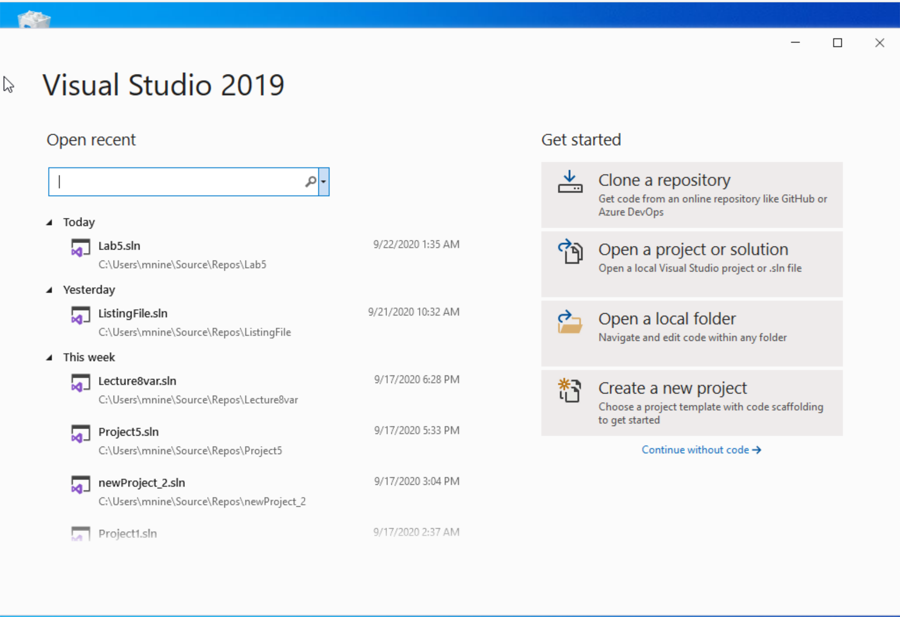


Step 1: Create a project (1)
Start Visual Studio
Click Create a new Project

Slide 28
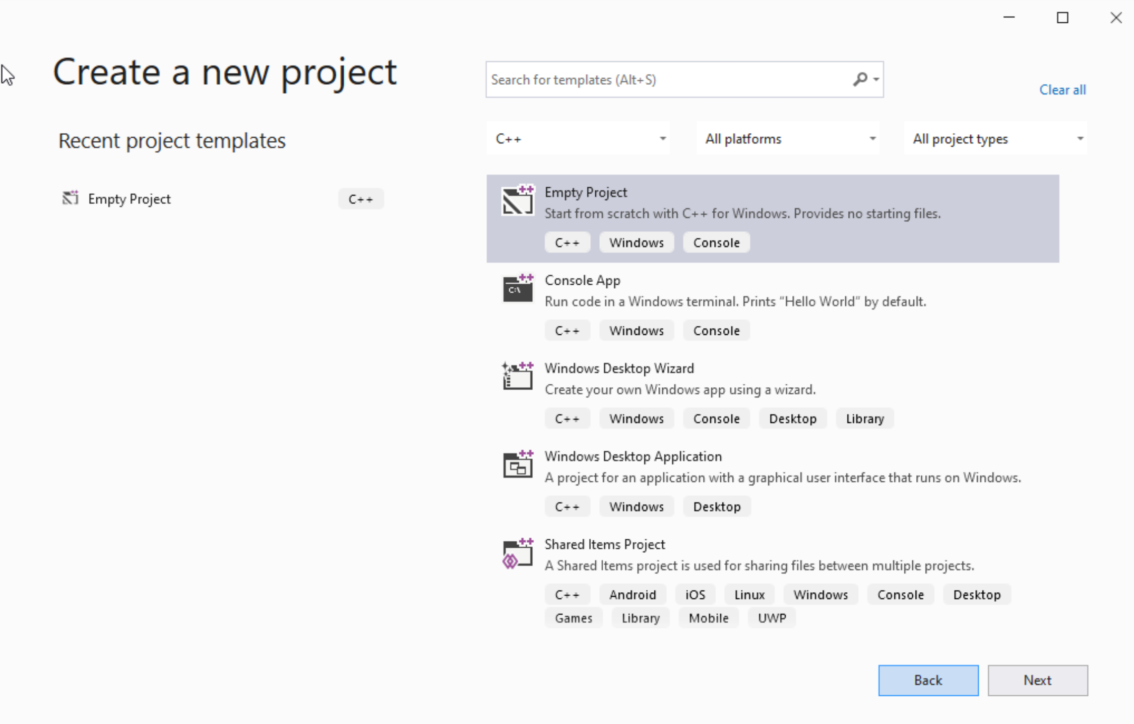




Step 1: Create a project (2)
Select C++ as language
Select Empty Project
Click Next

Slide 29
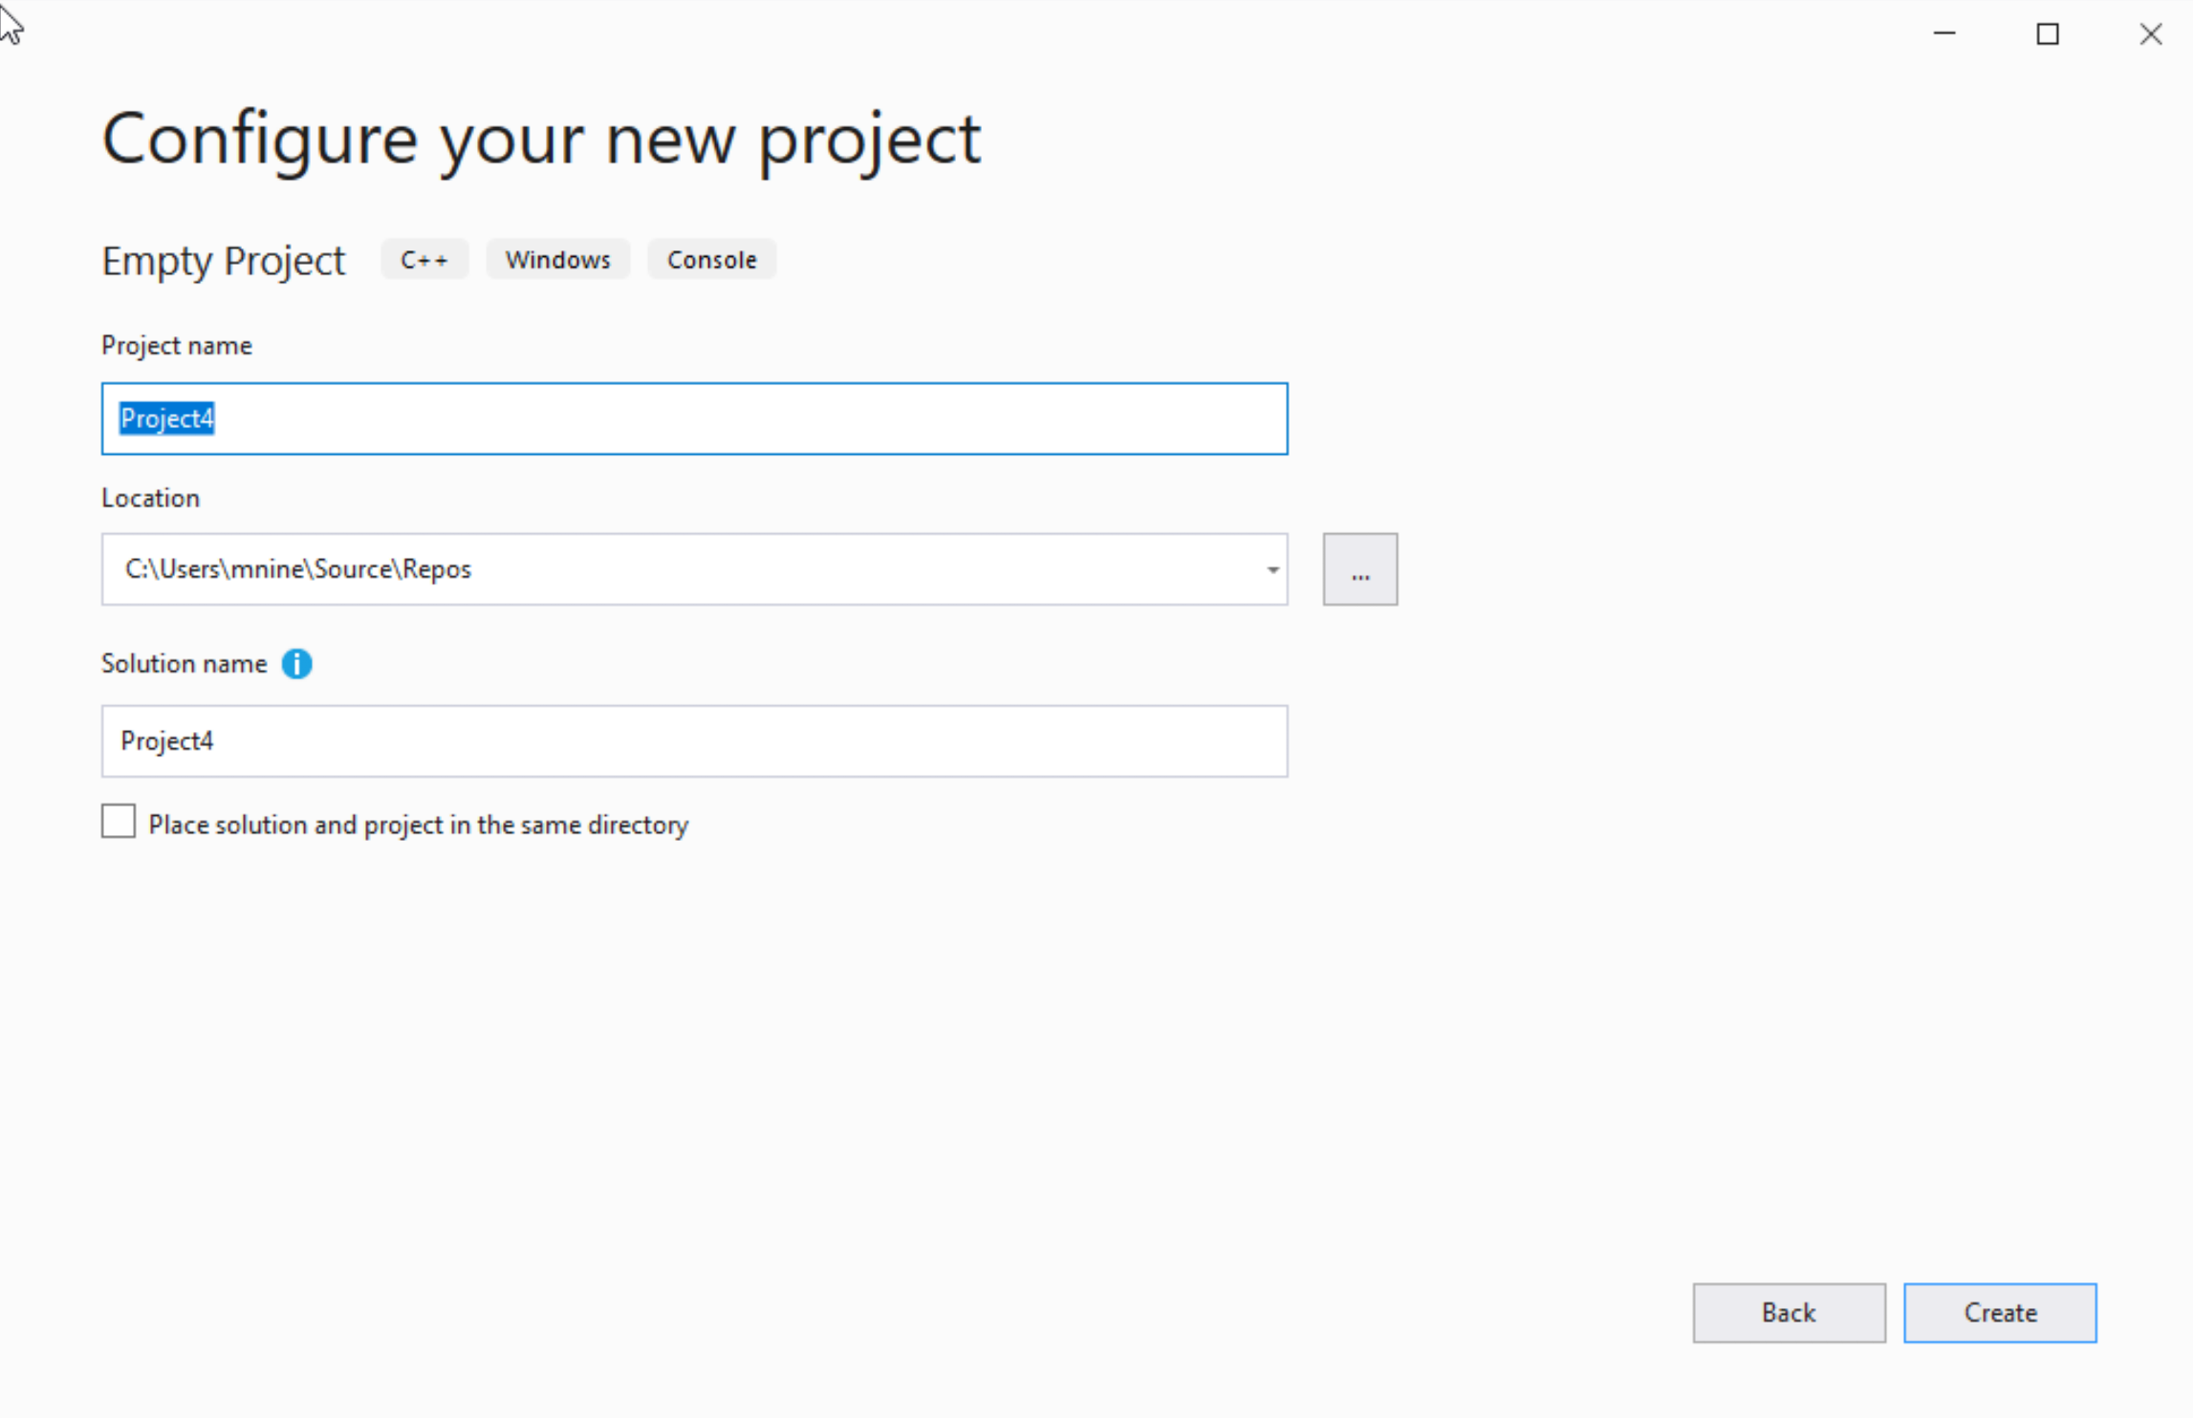

Step 1: Create a project (3)
You can change the project
name as you like
Also, you can change the
project location
Click Next

Slide 30
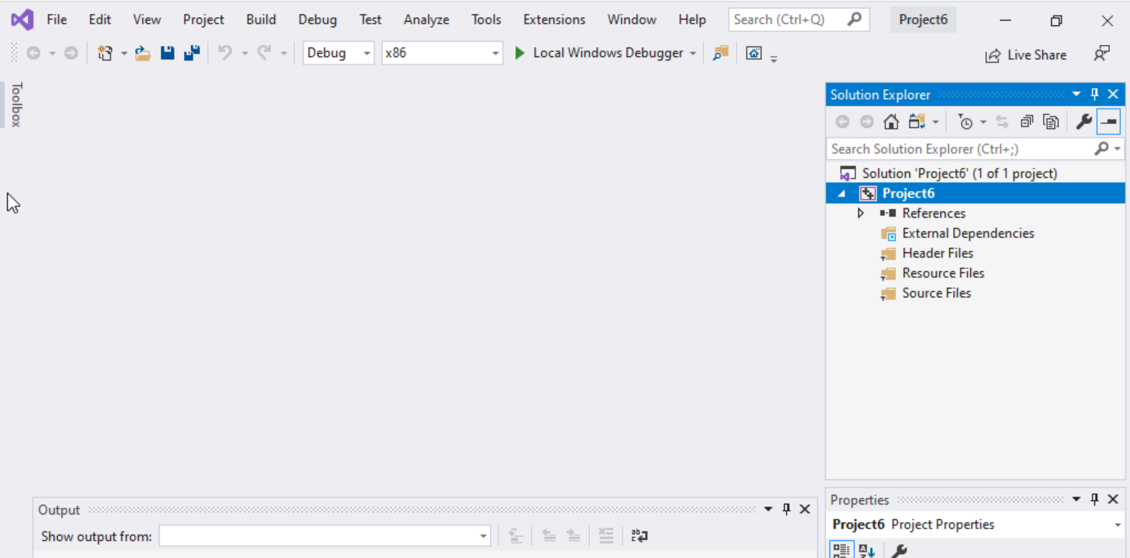
Step 1: Create a project (4)
Delete the
Following folders:
Header files
Resources Files, and
Source Files

Slide 31
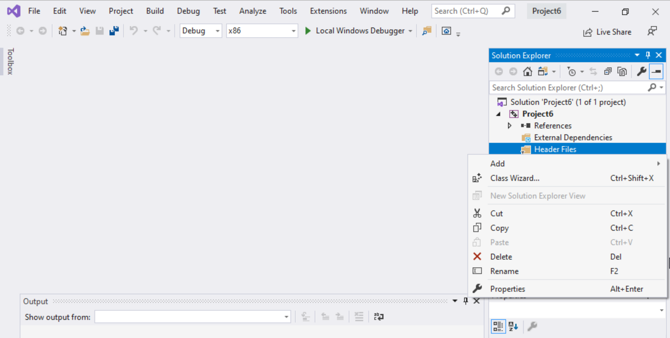
Step 1: Create a project (5)
To delete :
Select the folders
Right click on it
Select delete

Slide 32
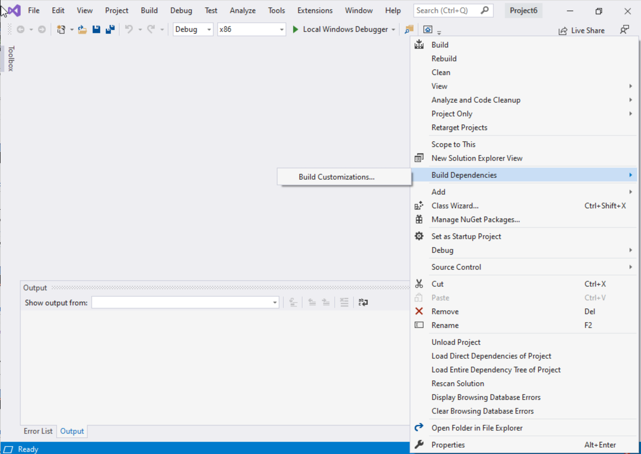
Step 1: Create a project (6)
Select Project Name on solution explorer
Right click on it
Go to Build Dependencies
Click on Build Customizations

Slide 33
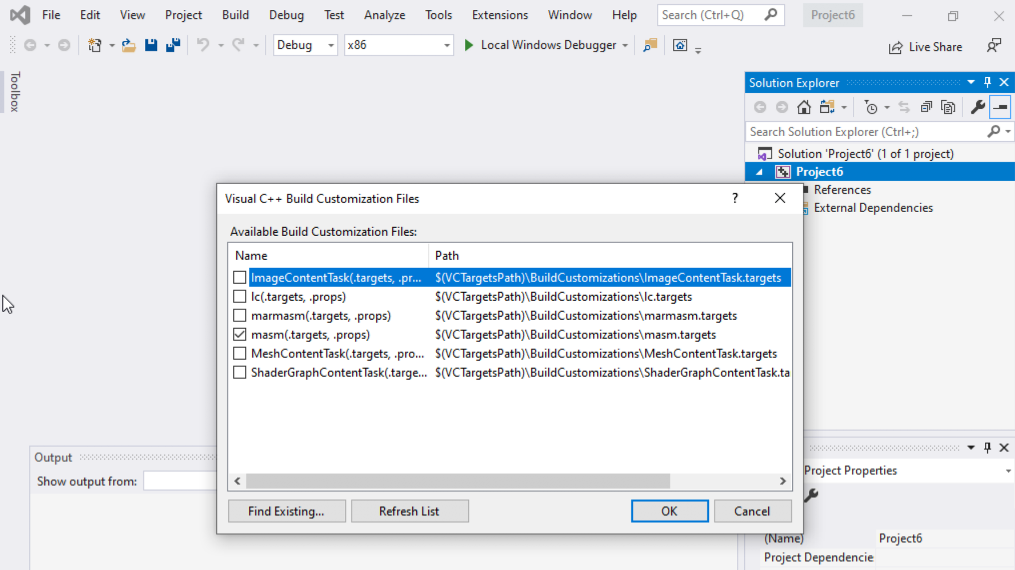
Step 1: Create a project (7)
Select masm(.target, .props)
Click ok

Slide 34
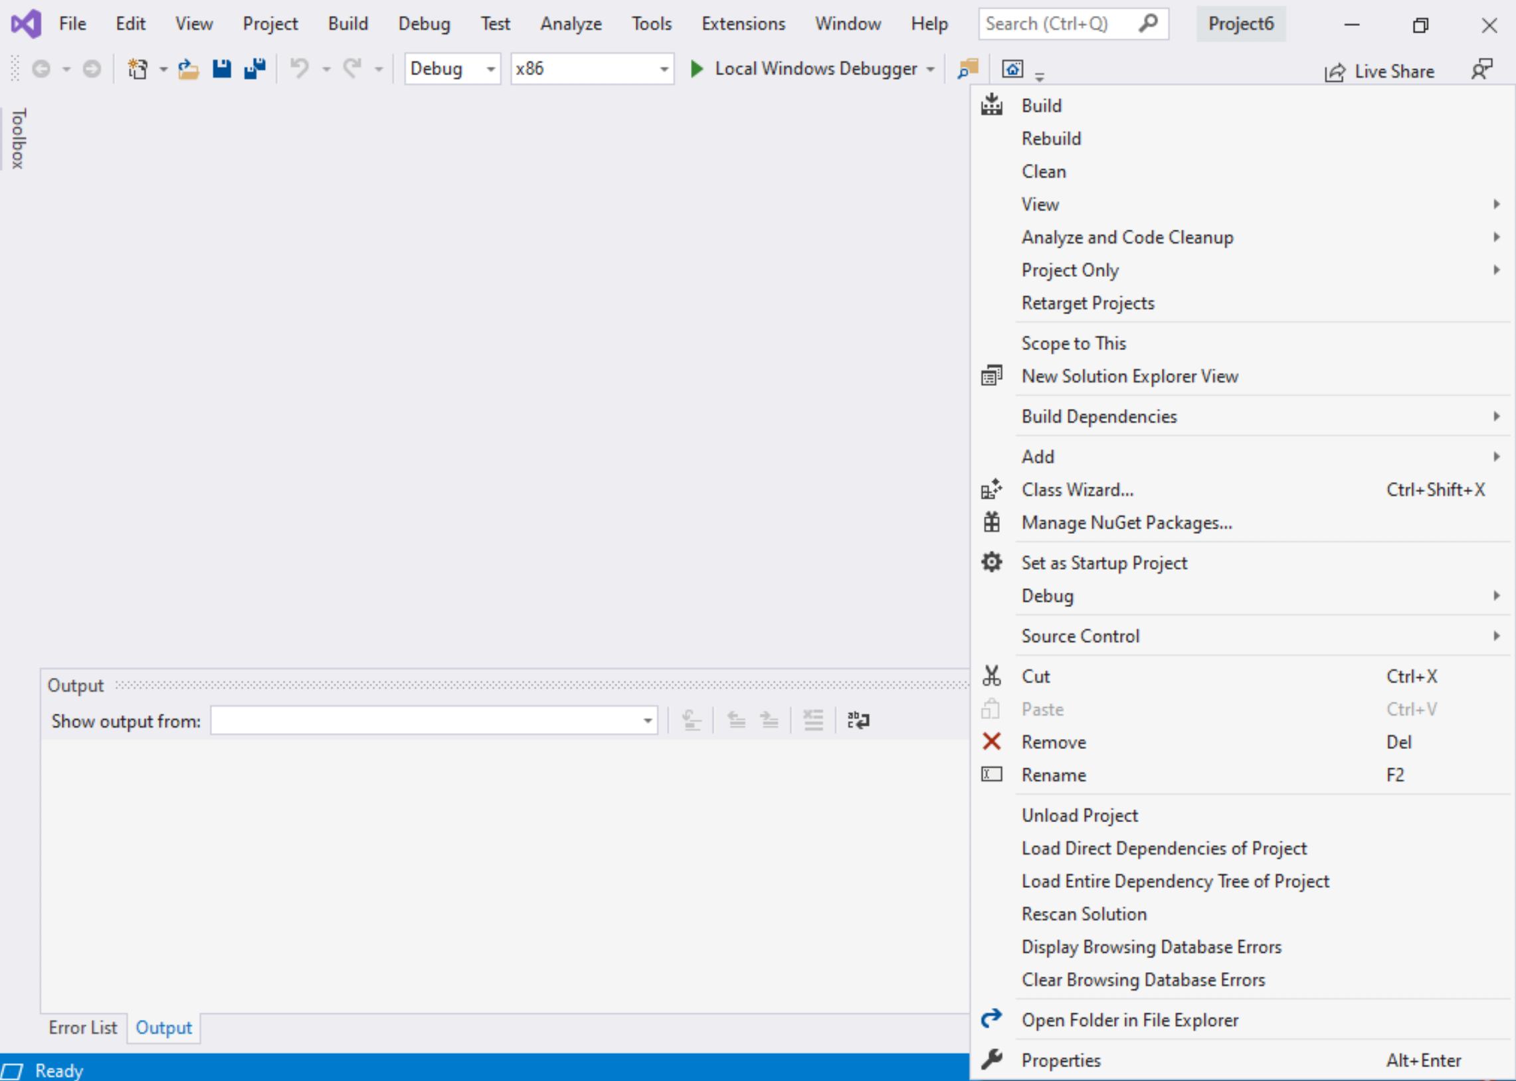
Step 1: Create a project (8)
Right click on the Project name in the solution explorer
Click properties

Slide 35
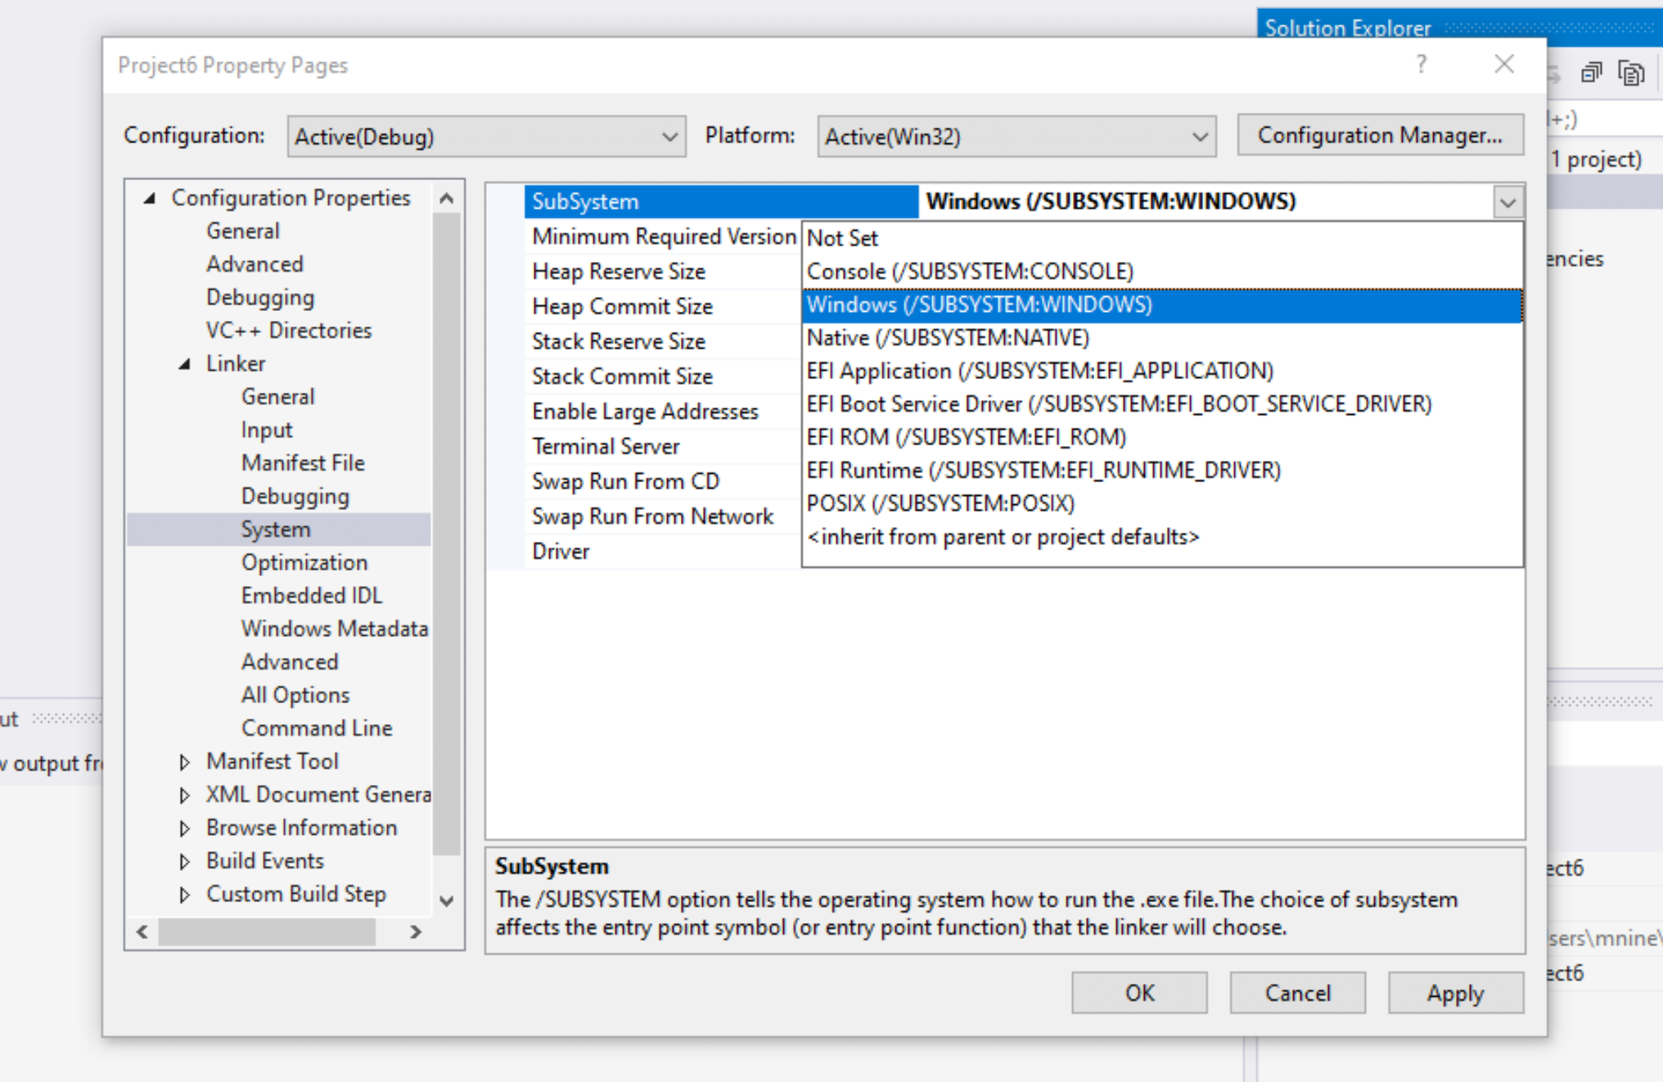

Step 1: Create a project (9)
Expand the ‘Linker’
Select ’System’
Select Windows(/SUBSYSTEM:WINDOWS)
Click OK

Slide 36
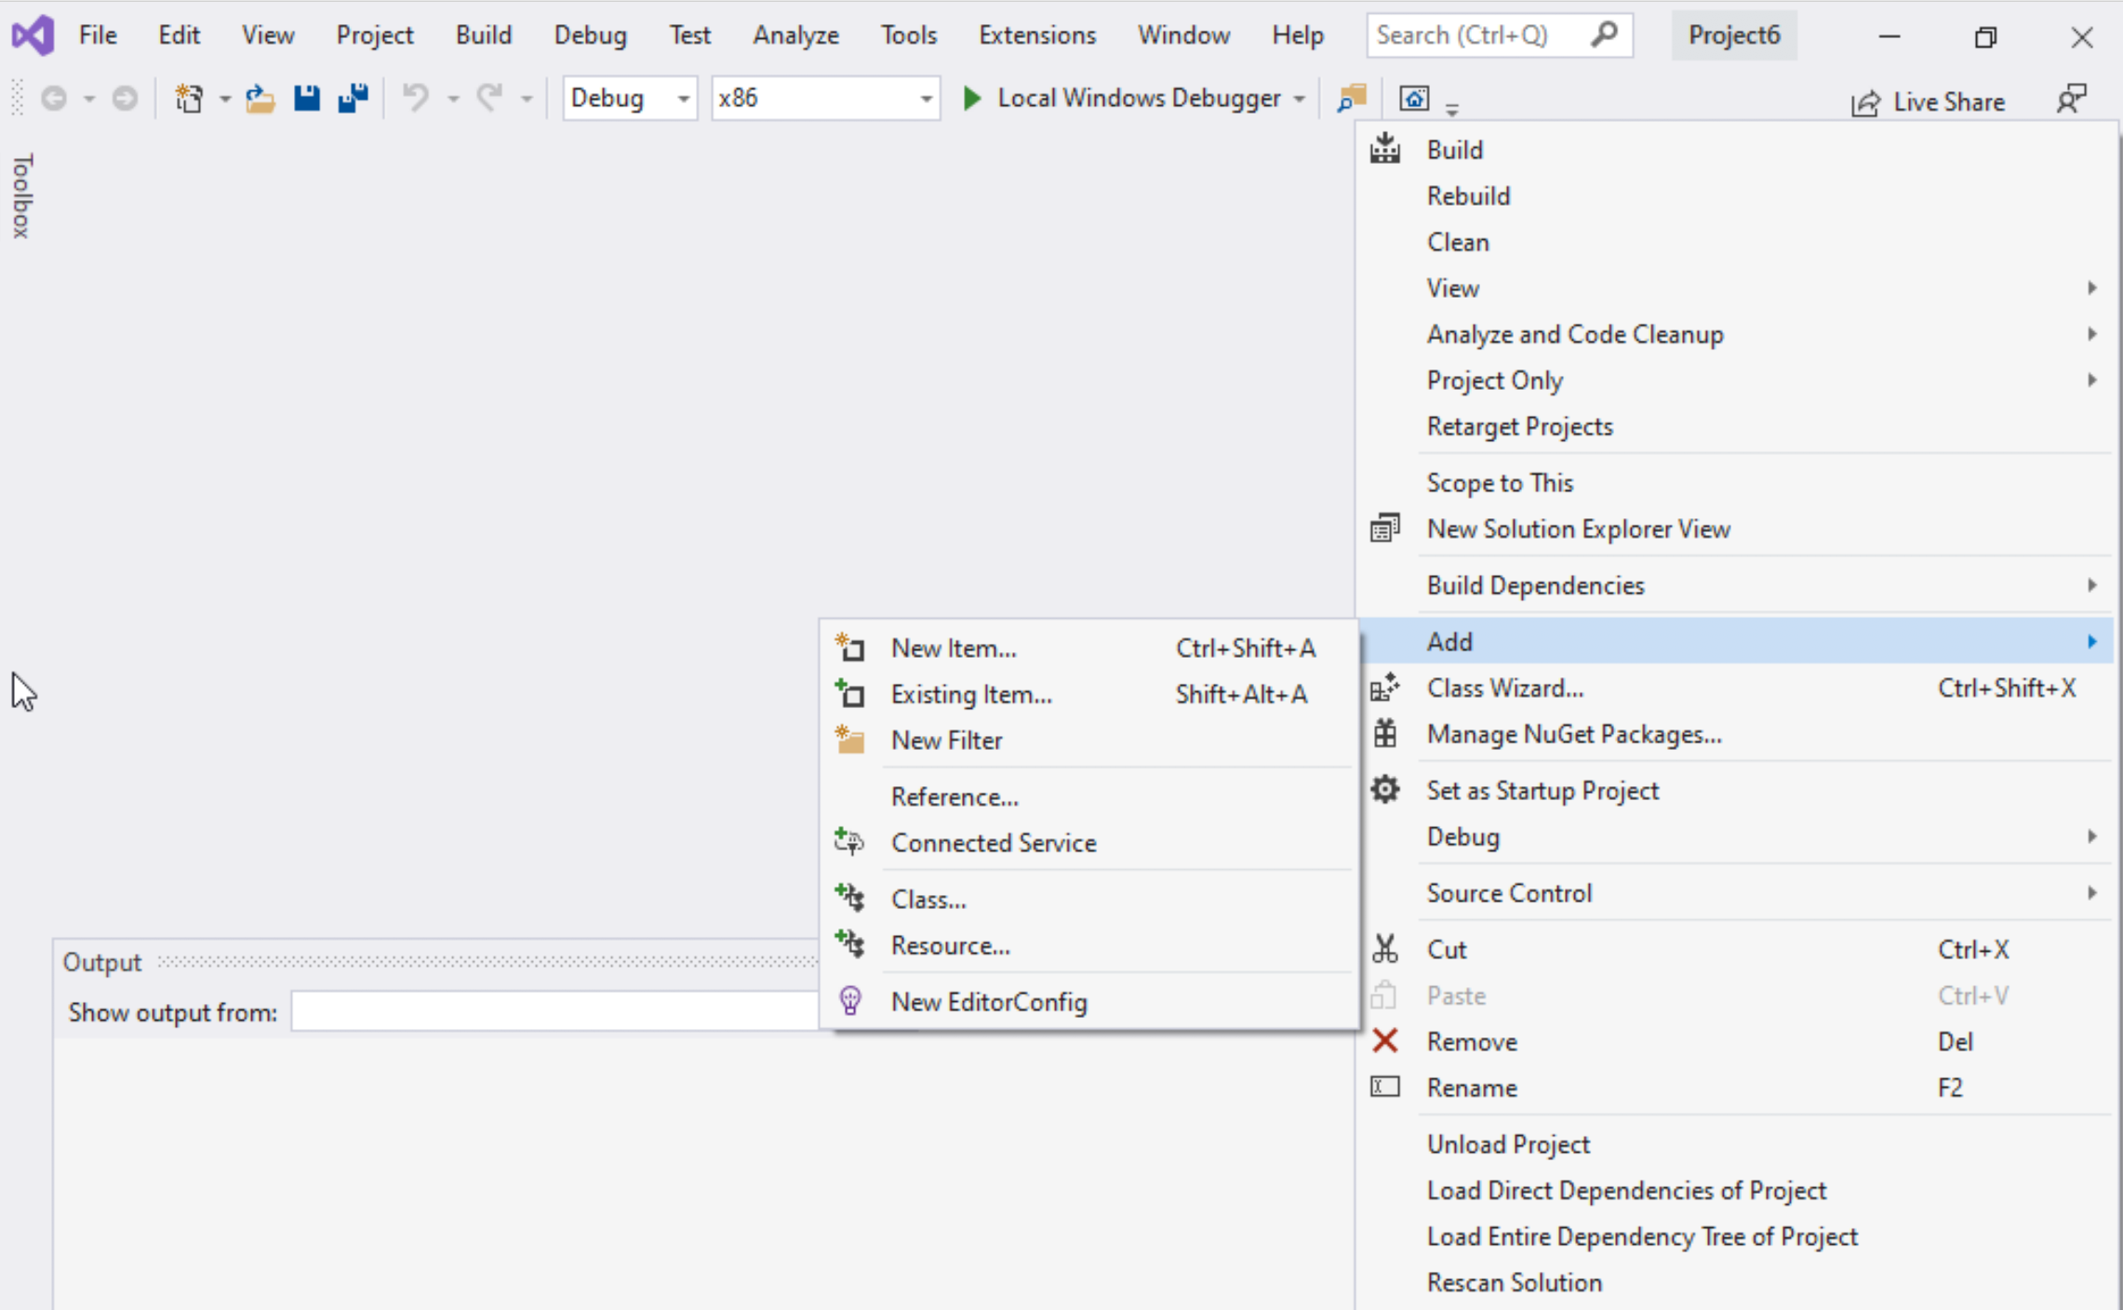
Step 1: Create a project (10)
Select Project name on solution explorer
Right click on it
Expand Add
Choose New Item

Slide 37
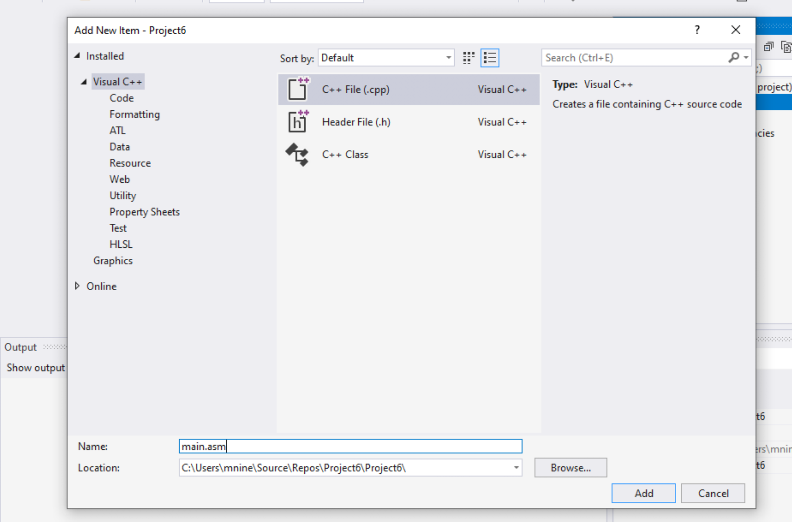


Step 1: Create a project (11)
Select C++ File(.cpp)
Name: main.asm
Click Add

Slide 38
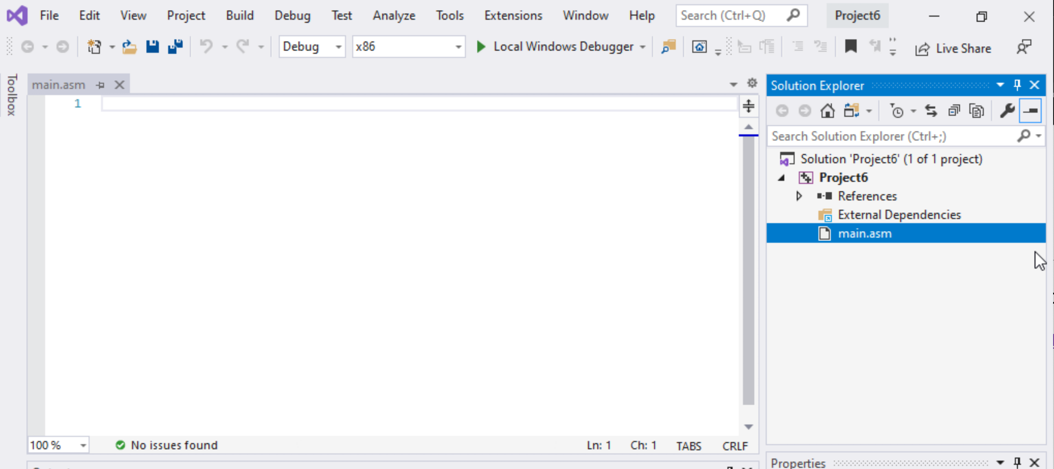

Step 1: Create a project (12)
Select main.asm
Add your code
In the main.asm File.

